Slide 1
PBJ4: Divergent SARS-CoV-2 Omicron–reactive T and B cell responses in COVID-19 vaccine recipients
Geurts van Kessel et al. Science Immunology. 2022.
Carlos Leon and Megan Costa

Slide 2
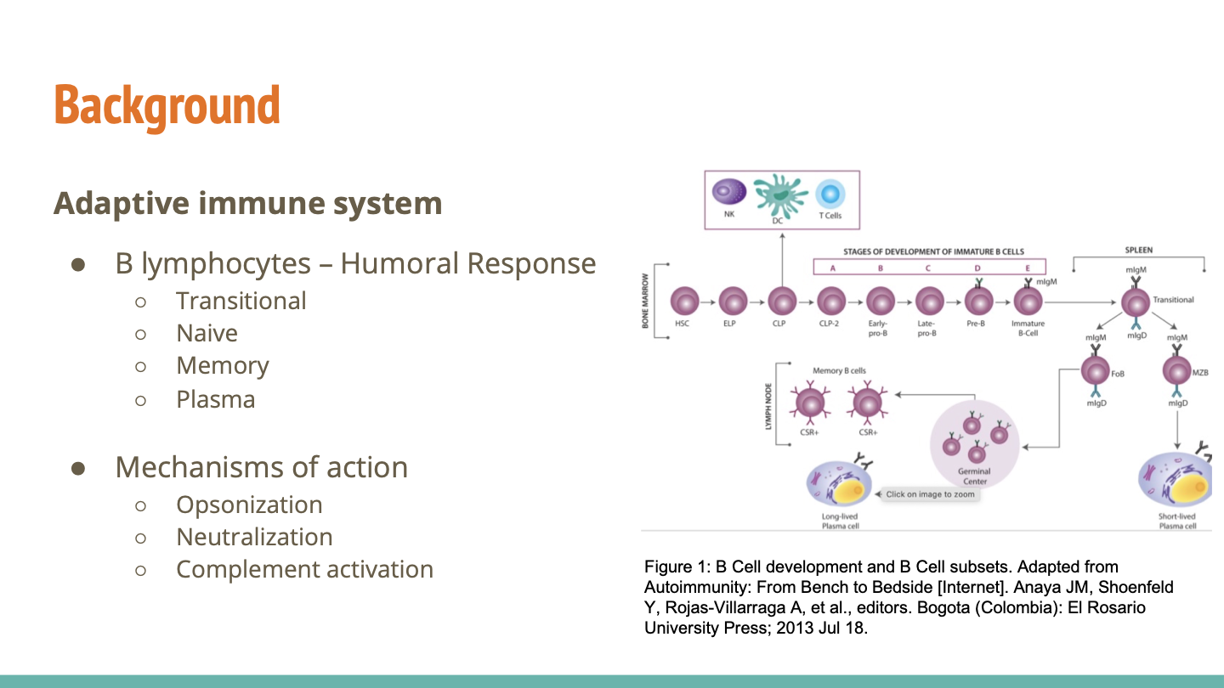
Background
Information about the adaptive immune system
B cells (different types)
T cells (different types) CD8+ wirth MHCI and CD4+ with MHCII
How do these cell interact with each other?
Neutralizing antibodies
Different ways that the adaptive immune system eliminates pathogens/foreign substances
Protection from infection rating in the clinical trial setting = vaccine efficacy
:T cell responses in household contacts suggested that higher levels of nucleocapsid-specific, IL-2-secreting T cells were found in individuals who did
not become infected compared with those who became infected22.”
We can explain what IL-2 is and its role
Notes:
1. Transitional B Cells
A transitional B cell is the link between immature and mature B cells. While they cannot perform any actions to help fend off harmful pathogens, they do travel between the bone marrow and secondary lymphoid tissues. During this time, they are subjected to checks to confirm they will not produce autoantibodies, or antibodies that attack the host.
Transitional cells are rarely targeted in B cell separation because they do not have as specific of a function as the others. Studying them inside the body is helpful enough.
The intermediate between immature and mature B cells
They undergo checks to make sure they are not producing antibodies that attack the host
Do not have a specific purpose
2. Naïve B Cells
Naïve B cells are the next step beyond transitional B cells. After the B lymphocyte matures, whether in the bone marrow or secondary lymphoid organs, it will remain a naïve blood cell until it is activated.
Activation occurs when a mature B cell is exposed to the antigen-presenting cells specific to its B cell receptor. Upon activation, a naïve B cell can become a plasma B cell or a memory B cell. Naïve cells don’t fight infection, they simply wait to be activated by a T cell or an antigen-presenting cell (APC).
Naive B cells can be studied, activated, and manipulated with biochemicals that help researchers learn more about the immune system. They have slightly different regulatory markers than the other cells which allows them to be isolated. For example, naive B cells are signaled by CD19+, CD27–, and CD38–.
These are mature B cells that have matured in the bone marrow or secondary lymphoid organs
Remains in the blood waiting for activation by T cells or antigen-presenting cells, so they’re inactive until they are stimulated
Can be signaled by CD19+, CD27–, and CD38–, which are memory B cells
3. Memory B Cells
One important B cell variant is the memory B cell, a type of B lymphocyte that is necessary for building long-term immunities within the body. These cells remain in the bloodstream after an infection subsides. If the host is re-exposed to that same antigen in the future, memory B cells can quickly activate with the help of T cells.
With the extra antibodies created by memory B cells, the immune system can often fend off familiar pathogens before the infection becomes symptomatic. Memory B cells have a CD19+, a CD27+, and a CD38– marker. The different expression on the CD27 marker allows scientists to isolate memory cells and naive cells with only one biomarker.
After activation, memory B cells are responsible for producing antibodies that are specific for an antigen
This would be a quicker response compared to when you are first exposed to an infection or pathogen
4. Plasma B Cells
Plasma B cells, also called effector B cells, are large cells with a very large endoplasmic reticulum (ER). The ER is responsible for helping to synthesize and transport proteins. This composition allows plasma cells to produce large quantities of antigen-specific antibodies.
Plasma cells respond to signal chemicals secreted by T cells during an infection. They continue making antibodies to fight the infection until it is controlled or eliminated. Plasma cells can often be found at the site of chronic inflammation.
Plasma B cells are similar to memory B cells but with a CD38+ biomarker. Because this marker is difficult to target, researchers often sort plasma B cells with FACS and a flow cytometer. With three different lasers, researchers can isolate all three unique cell populations (naive, memory, and plasma) at once with a high throughput. The efficiency of this sort can be dramatically improved by first enriching the sample for B cells (using a sample preparation method like BACS) before sorting the B cells into their subtypes with FACS.
Plasma cells are also referred to as effector B cells
They are large B cells with a very large endoplasmic reticulum
As we know, the ER is responsible for synthesizing and transporting proteins, so plasma cells are able to produce large amounts of antigen-specific antibodies
Are identified with a CD38⁺ biomarker, but these cells are difficult to isolate within the lab setting. Researchers try to isolate the cells with the use of fluorescence-activated cell sorting, which is a specialized type of flow cytometry
Researches are able to better target naive, memory, and plasma cells with three different lasers when doing flow cytometry and using Buoyancy Activated Cell Sorting, also known as BACS, is the process of sorting cells by using buoyant microbubbles. By coating the microbubbles with antibodies, the target cells attach to the surface of the microbubbles, effectively separating them from the non-target cells. Then the microbubbles—composed of a gaseous core that is often shelled by polymers, lipids, or proteins—float the target cells to the top of the sample.
________________________________________________________________________________________________________
Opsonization
- Antibodies promote phagocytosis
Neutralization
- Antibodies prevent adherence
Complement activation
- Antibodies activate complement response, which enhances opsonization and lysis pathogens
https://www.ncbi.nlm.nih.gov/books/NBK459471/

Slide 3
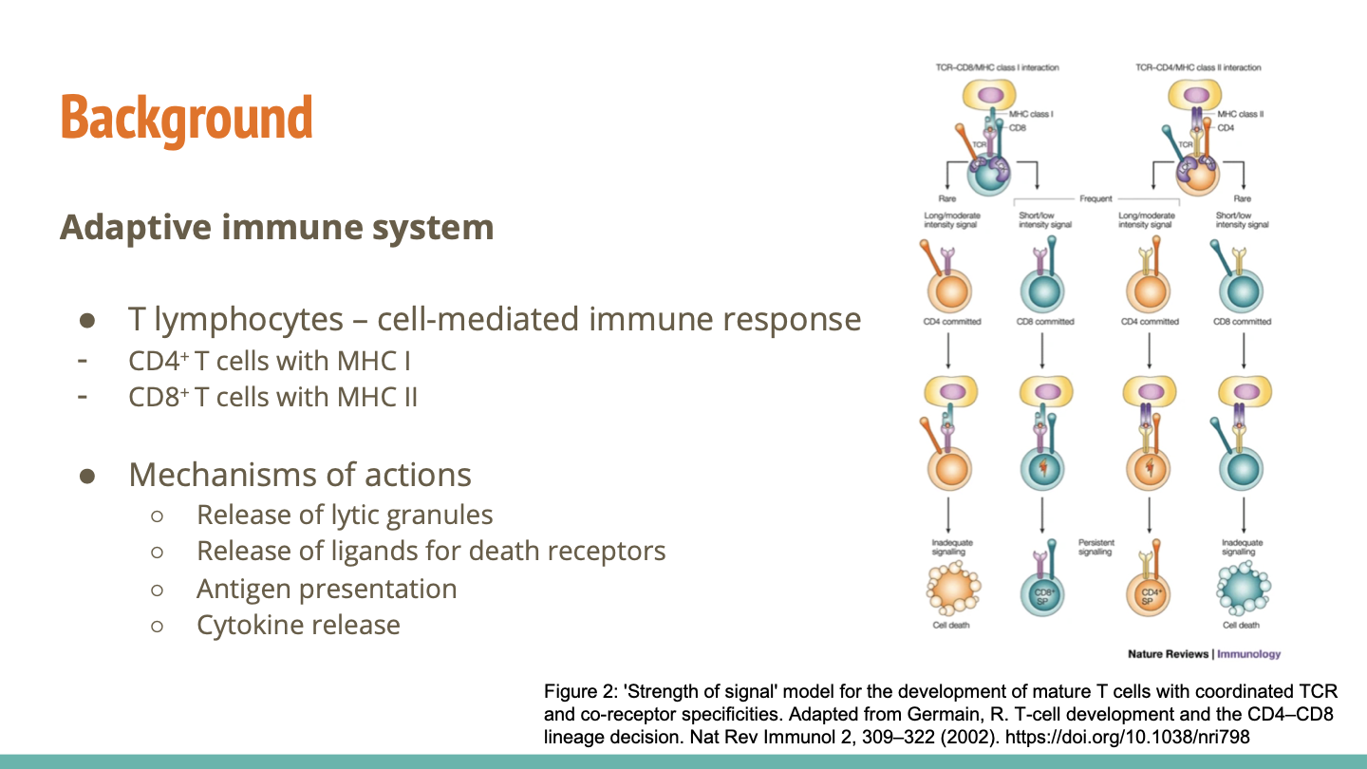
Notes:
●T cells are so called because they are predominantly produced in the thymus. They recognise foreign particles (antigen) by a surface expressed, highly variable, T cell receptor (TCR). There are two major types of T cells: the helper T cell and the cytotoxic T cell. As the names suggest helper T cells ‘help’ other cells of the immune system, whilst cytotoxic T cells kill virally infected cells and tumors.
●Unlike antibody, the TCR cannot bind antigen directly. Instead it needs to have broken-down peptides of the antigen ‘presented’ to it by an antigen presenting cell (APC). The molecules on the APC that present the antigen are called major histocompatibility complexes (MHC). There are two types of MHC: MHC class I and MHC class II. MHC class I presents to cytotoxic T cells; MHC class II presents to helper T cells.
T lymphocytes are produced in the thymus and there are two major categories of T cells
CD4⁺ T cells are also called your helper T cells because they are the ones that aid in activating B cells and other T cells
CD8⁺ T cells are also referred to as you killer T cells because they actively eradicate infected cells by releasing lytic granules
MHC class I glycoproteins present antigens that originate from the cytoplasm - this is very important for immune cells to identify which cells are healthy or infected
MHC class II proteins present exogenous antigens that originate extracellularly from from foreign bodies such as bacteria
An example of this is when a macrophage engulfs a bacterium and breaks it down to present the antigen onto the MHC class II so that other immune cells like CD8⁺ T cells can recognize them to target them
Mechanisms of action
Lytic granule
Release of ligands such as tumor necrotic factor or Fas ligand that initiate apoptosis within an infected cell so it cannot infect other cells
T cells also work with antigen presenting cells like dendritic cells to activate B cells
Cytokines are released to recruit macrophages, natural killer cells, and B cells. IL-2 is produced by T cells and stimulates the proliferation of B cells

Slide 4
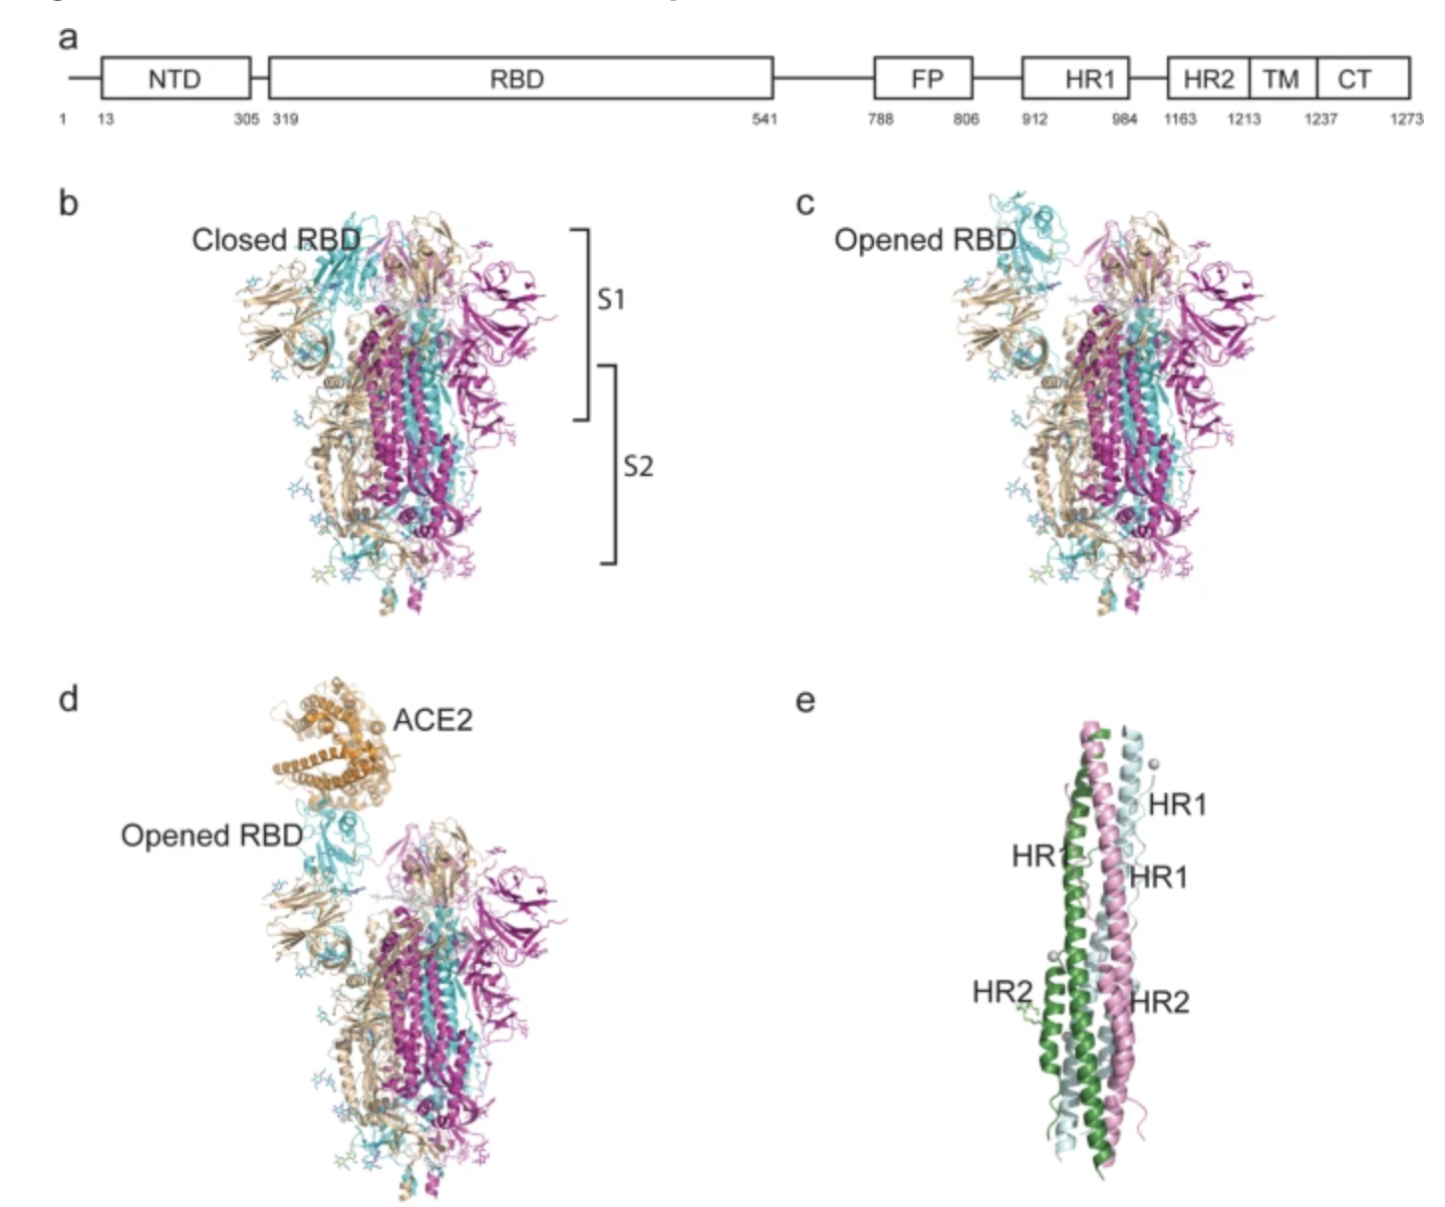
Background
S Protein of SARS-CoV-2
Structure
Trimeric class I transmembrane protein
Crown-like structure
Two subunits
S1
S2
Function
Bind to ACE2 receptor
Figure 3: Structure of the SARS-CoV-2 S protein. Adapted from Huang, Y., Yang, C., Xu, Xf. et al. Structural and functional properties of SARS-CoV-2 spike protein: potential antivirus drug development for COVID-19. Acta Pharmacol Sin 41, 1141–1149 (2020). https://doi.org/10.1038/s41401-020-0485-4
Notes:
Structure section
N-terminal domain (14–305 residues) and a receptor-binding domain (RBD, 319–541 residues); the fusion peptide (FP) (788–806 residues), heptapeptide repeat sequence 1 (HR1) (912–984 residues), HR2 (1163–1213 residues), TM domain (1213–1237 residues), and cytoplasm domain (1237–1273 residues) comprise the S2 subunit
In the native state, the CoV S protein exists as an inactive precursor. During viral infection, target cell proteases activate the S protein by cleaving it into S1 and S2 subunits [17], which is necessary for activating the membrane fusion domain after viral entry into target cells [18]. Similar to other coronaviruses, the S protein of SARS-CoV-2 is cleaved into S1 and S2 subunits by cellular proteases, and the serine protease TMPRSS2 is used as a protein primer. Although the cleavage site of SARS-CoV is known, that of SARS-CoV-2 S has not yet been reported [18, 19].
Function section
SARS-CoV-2 S protein binds to the host cell by recognizing the receptor ACE2 [33]. ACE2 is a homolog of ACE, which converts angiotensin I to angiotensin 1–9 [35]. ACE2 is distributed mainly in the lung, intestine, heart, and kidney, and alveolar epithelial type II cells are the major expressing cells [36].
ACE2 is also a known receptor for SARS-CoV. The S1 subunit of the SARS-CoV S protein binds with ACE2 to promote the formation of endosomes, which triggers viral fusion activity under low pH (Fig. 1a, b) [37].
ACE2 = angiotensin converting enzyme 2
Angiogentsin is important for producing aldosterone to increase blood pressure

Slide 5
Background
Vaccine-induced protection from infection
Operationalization within trials
Kent et al. reports the level of neutralization by antibodies induced by vaccines determines a vaccine’s efficacy
Monoclonal administered prophylactically or post-exposure to SARS-CoV-2 has shown great protection to the virus
Testing
Difficulty in assessing T cell activity because of the lack of appropriate assays
Confounds: Measuring solely T cell activity is complicated because vaccines induce antibody production
Notes:
Disentangling the relative importance of T cell responses in COVID-19: leading actors or supporting cast?
There are different confounds when trying to test for T cells activity because vaccines that induce antibody production and affect the results for T cell activity (you’re not sure what is causing what)
monoclonal antibodies are better suited for therapeutic purposes than polyclonal antibodies due to their homogeneity, high specificity to a single epitope and their low degree of cross-reactivity.
Monoclonal antibodies are produced by one type of immune cells unlike polyclonal antibodies
Interferon-gamma measurements are used to analyze T-cell activity
- Healthcare workers that received the mRNA vaccine showcase the highest level of T-cell activity
oHowever, healthcare workers that received the adenovirus vaccine demonstrated a stable level of T-cell activity up to 6-months
Antibody half-life for post-infection or vaccination is 3-4 months
Vaccination works better in individuals that have had Sars-CoV-2

Slide 6
Background
T-cells as backup for antibodies
Kent et al. reports that the use of anti-CD20 reduces antibody levels and affect CD4⁺ cell responses
Increased CD8⁺ cell responses
Differential responses
Varying levels of B cells and T cells responses between immunocompetent patients and immunocompromised patients
Notes:
Introducing anti-CD20 (B cell depleting antibody) reduced antibody levels and CD4+ T follicular cell response alongside other CD4+ cell type responses among patients → decreased

Slide 7
Questions to be Addressed:
How does the severity of the Omicron variant correlate with vaccination status and preexisting immunity?
Which vaccine is the most effective? Is there a need for boosters against Omicron?
Is there a difference in antibody and T cell reactivity against Wild Type SARS-CoV-2, Beta, Delta, and Omicron?

Slide 8
Hypothesis
Neutralizing antibodies correlate with SARS-CoV-2 protection more than T cells
The authors hypothesize that mutations in the spike protein disrupt neutralizing antibody response more than T cell response.

Slide 9




Study Design and Sample Collection
N = 423 Participants from Erasmus Medical Center, 4 Vaccines
Neutralizing antibodies and T cells were assessed early, late, and post-booster

Slide 10
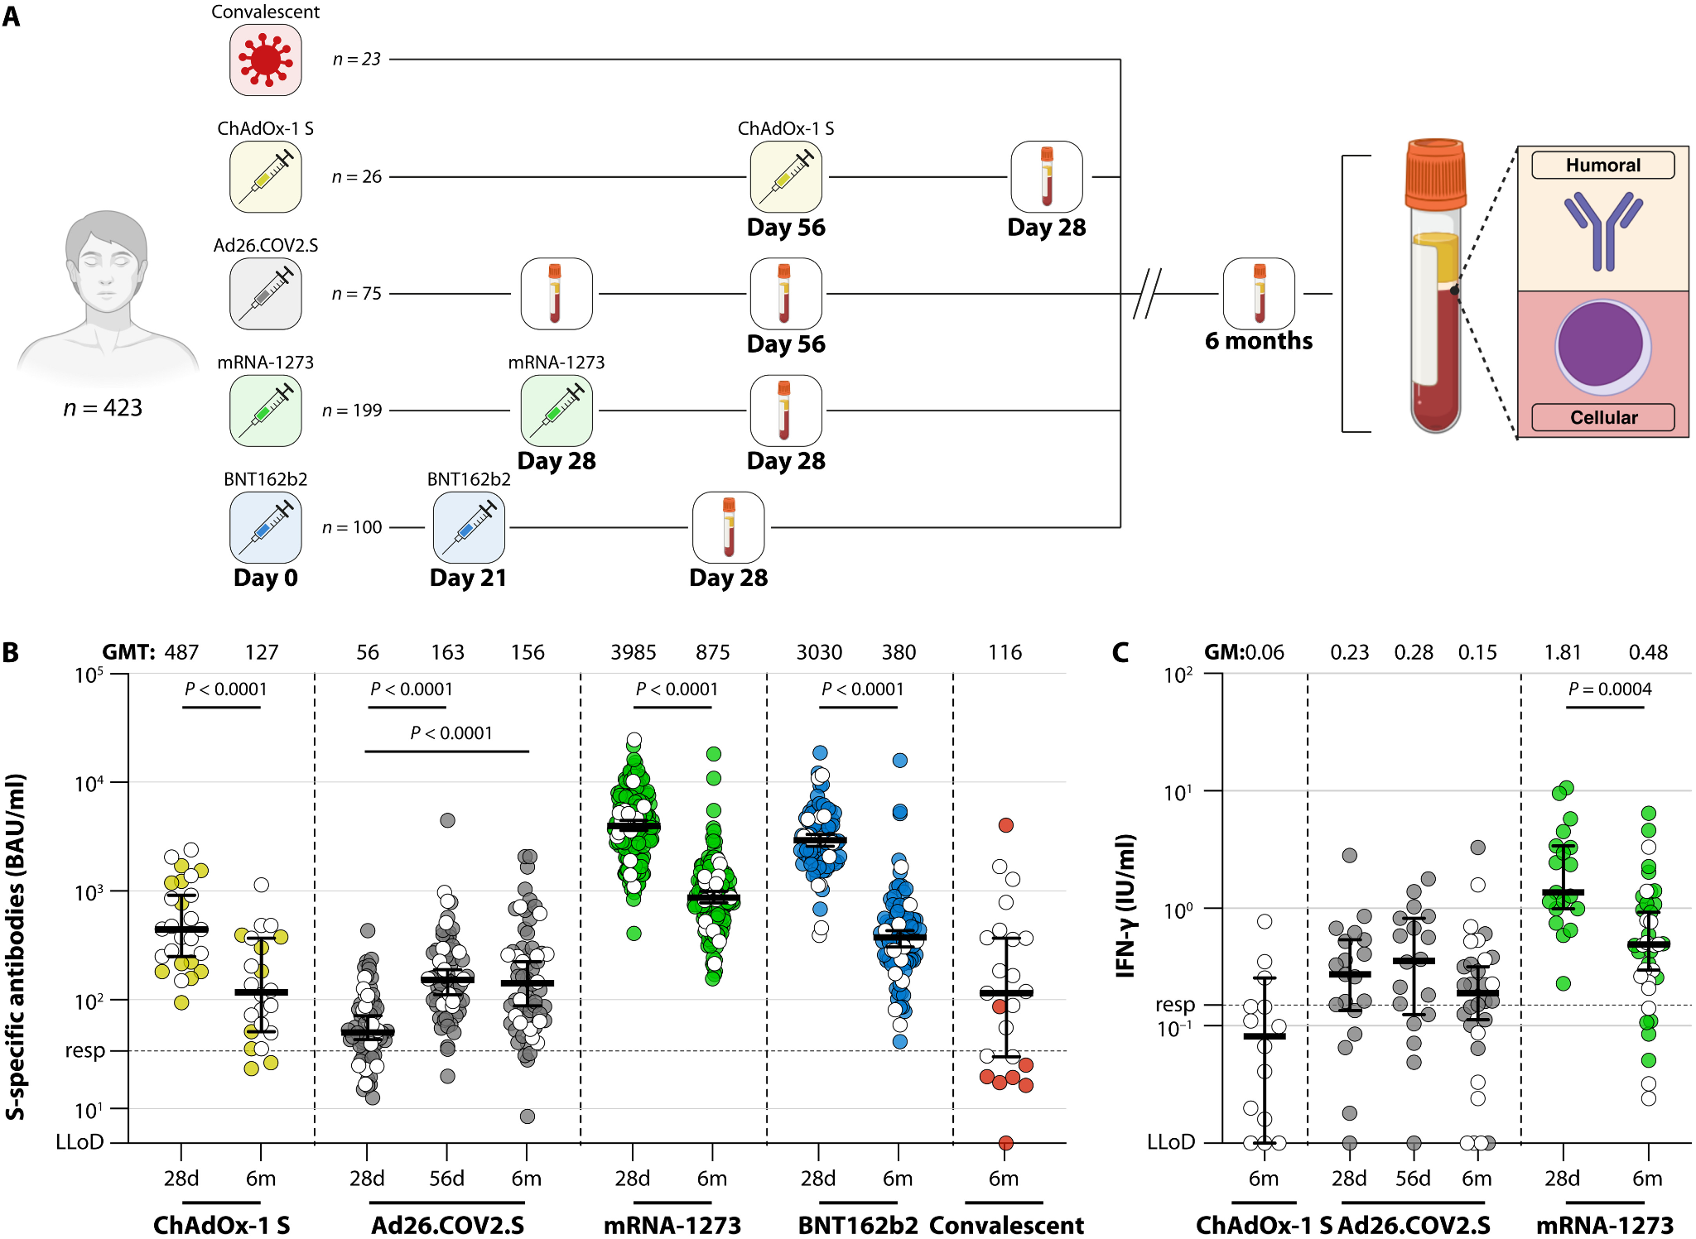
Figure 1 | Study design and detection of virus-specific binding antibodies and T cells
Plasma
Serum and peripheral blood mononuclear cells (PBMCs)

Slide 11
Cohort | n | Age (median years, 95% CI) | Female (n, %) | Vaccination interval (median days, 95% CI)
Convalescent | 23 | 48 (42–58) | 4 (17%) | N/A
In-depth | 15 | 53 (42–62) | 1 (7%) | N/A
ChAdOx-1 S | 26 | 63 (62–64) | 17 (61%) | 56 (56–70)
In-depth | 15 | 63 (62–64) | 9 (60%) | 56 (56–70)
Ad26.COV2.S | 75 | 37 (32–43) | 62 (83%) | N/A
In-depth | 15 | 38 (32–50) | 13 (87%) | N/A
mRNA-1273 | 199 | 41 (39–44) | 156 (78%) | 28 (28–28)
In-depth | 15 | 34 (27–40) | 12 (80%) | 25 (25–28)
BNT162b2 | 100 | 40.5 (37–45) | 66 (66%) | 21 (21–21)
In-depth | 15 | 46 (36–53) | 11 (73%) | 22 (21–25)

Slide 12
Figure 1 | Study design and detection of virus-specific binding antibodies and T cells
LLoD = Lower Limit of Detection
GMT = Geometric Mean Titer for antibodies
Had COVID

Slide 13

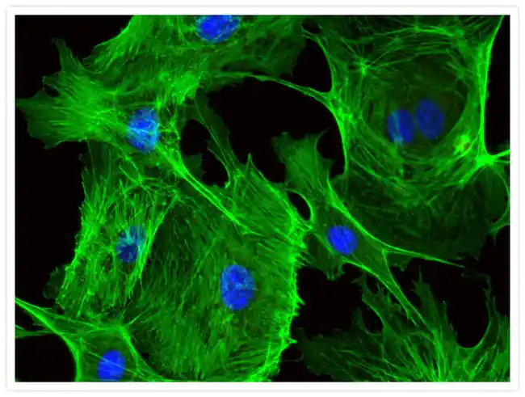
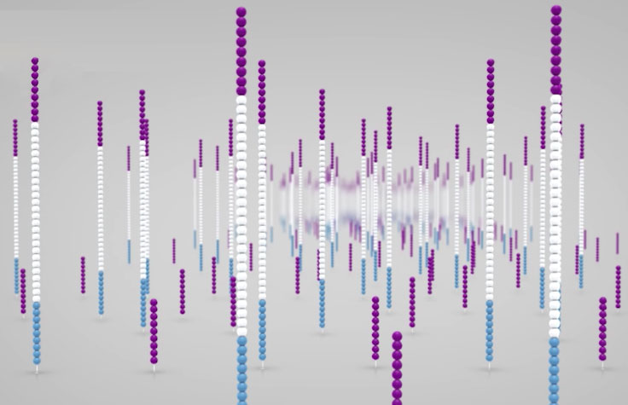
Plaque Reduction Neutralization Test (PRNT)
Infect SARS-CoV-2 into Calu-3 cells (MOI = 0.01) and grow to P3
Stain cells and calculate frequency of GFP-positive cells
Perform deep sequencing to confirm that P3 was essentially equal to P1 and characterize any mutations

Slide 14
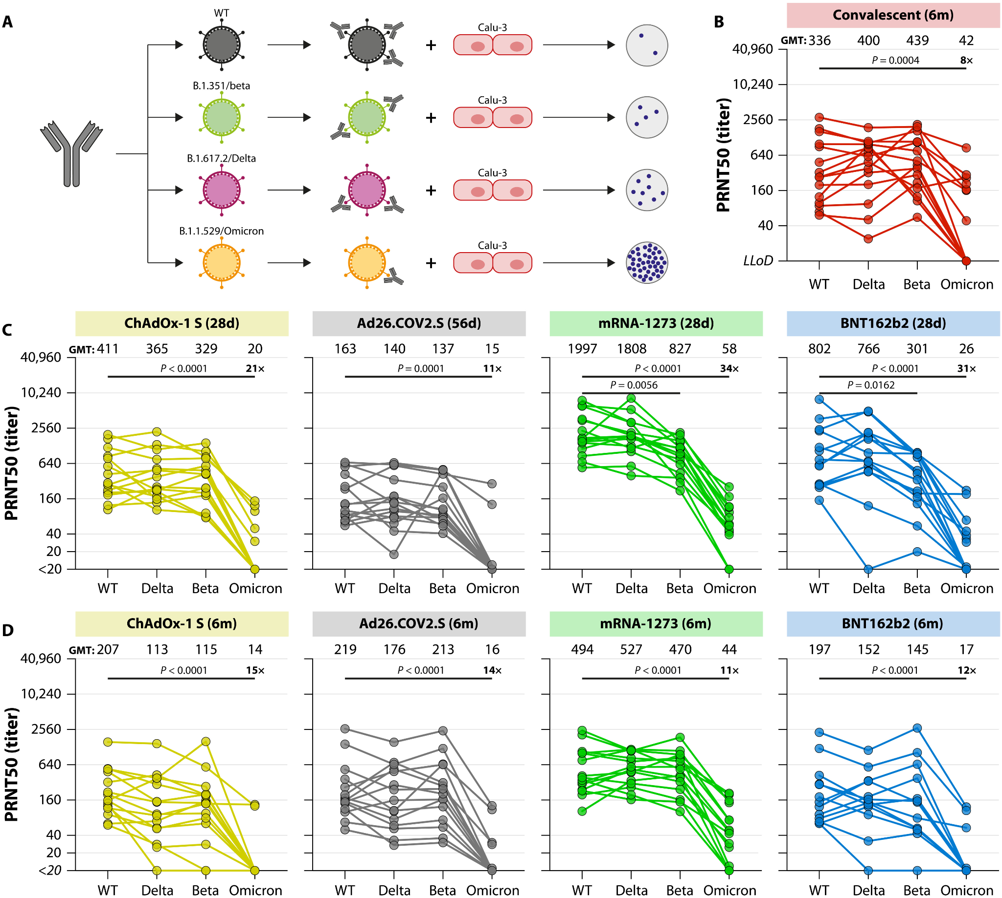
Figure 2 | SARS-CoV-2 variant-specific neutralizing antibody responses
Human airway cells

Slide 15
Figure 2 | SARS-CoV-2 variant-specific neutralizing antibody responses

Slide 16
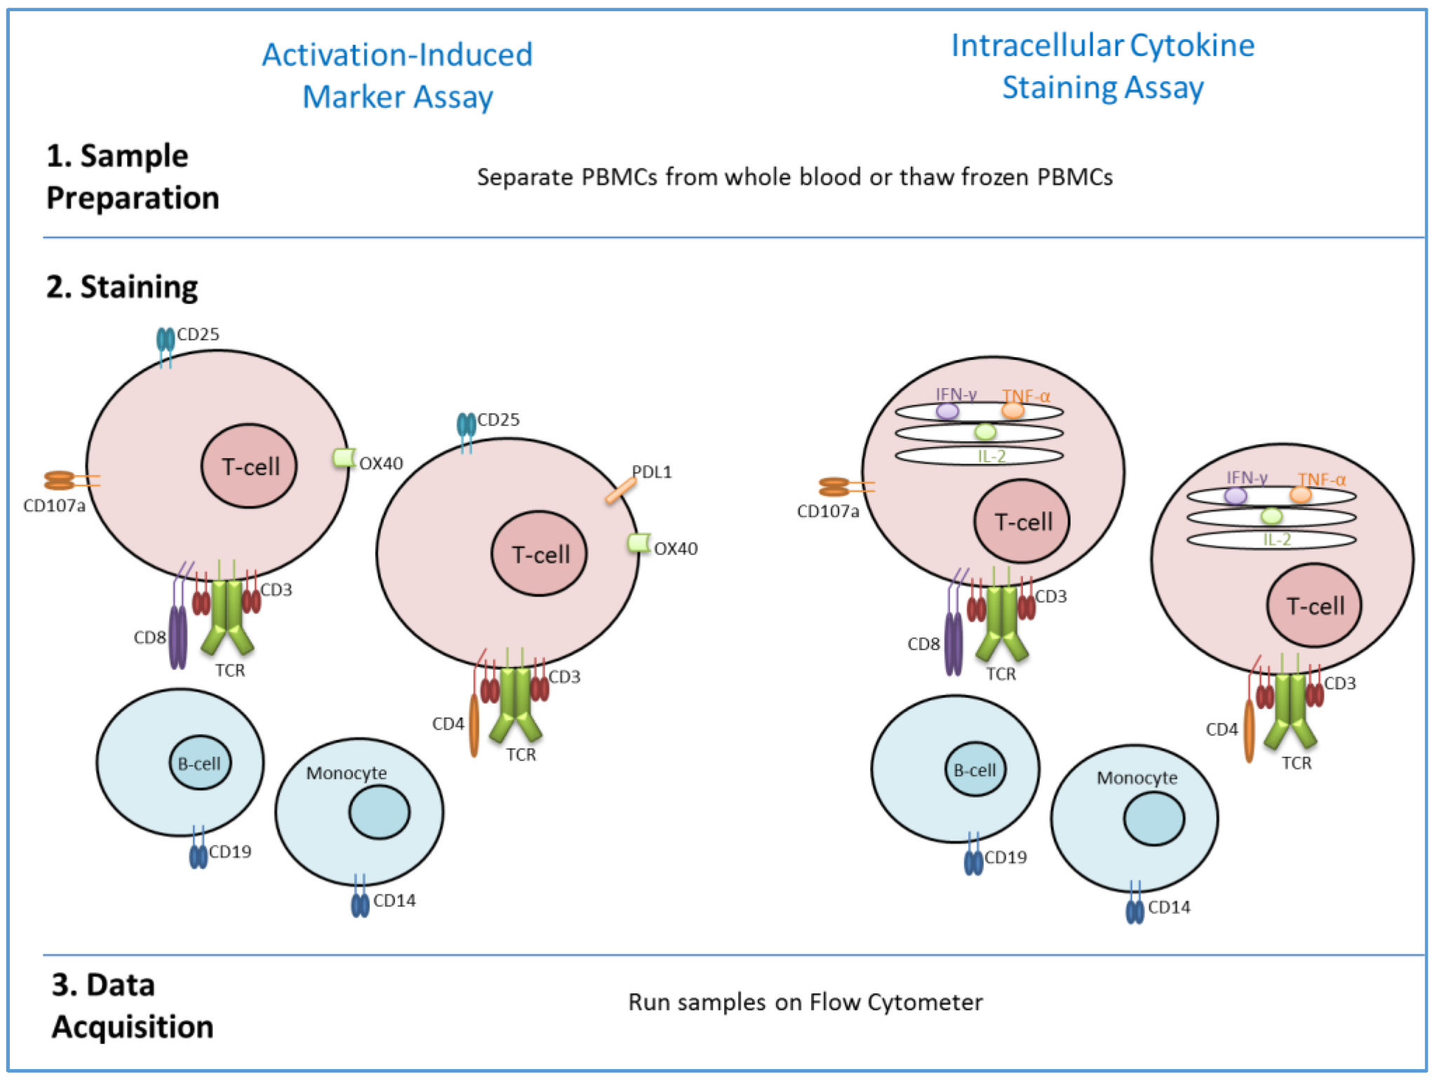
PBMC taken from n = 5 individuals vaccinated with BNT162b2

Slide 17
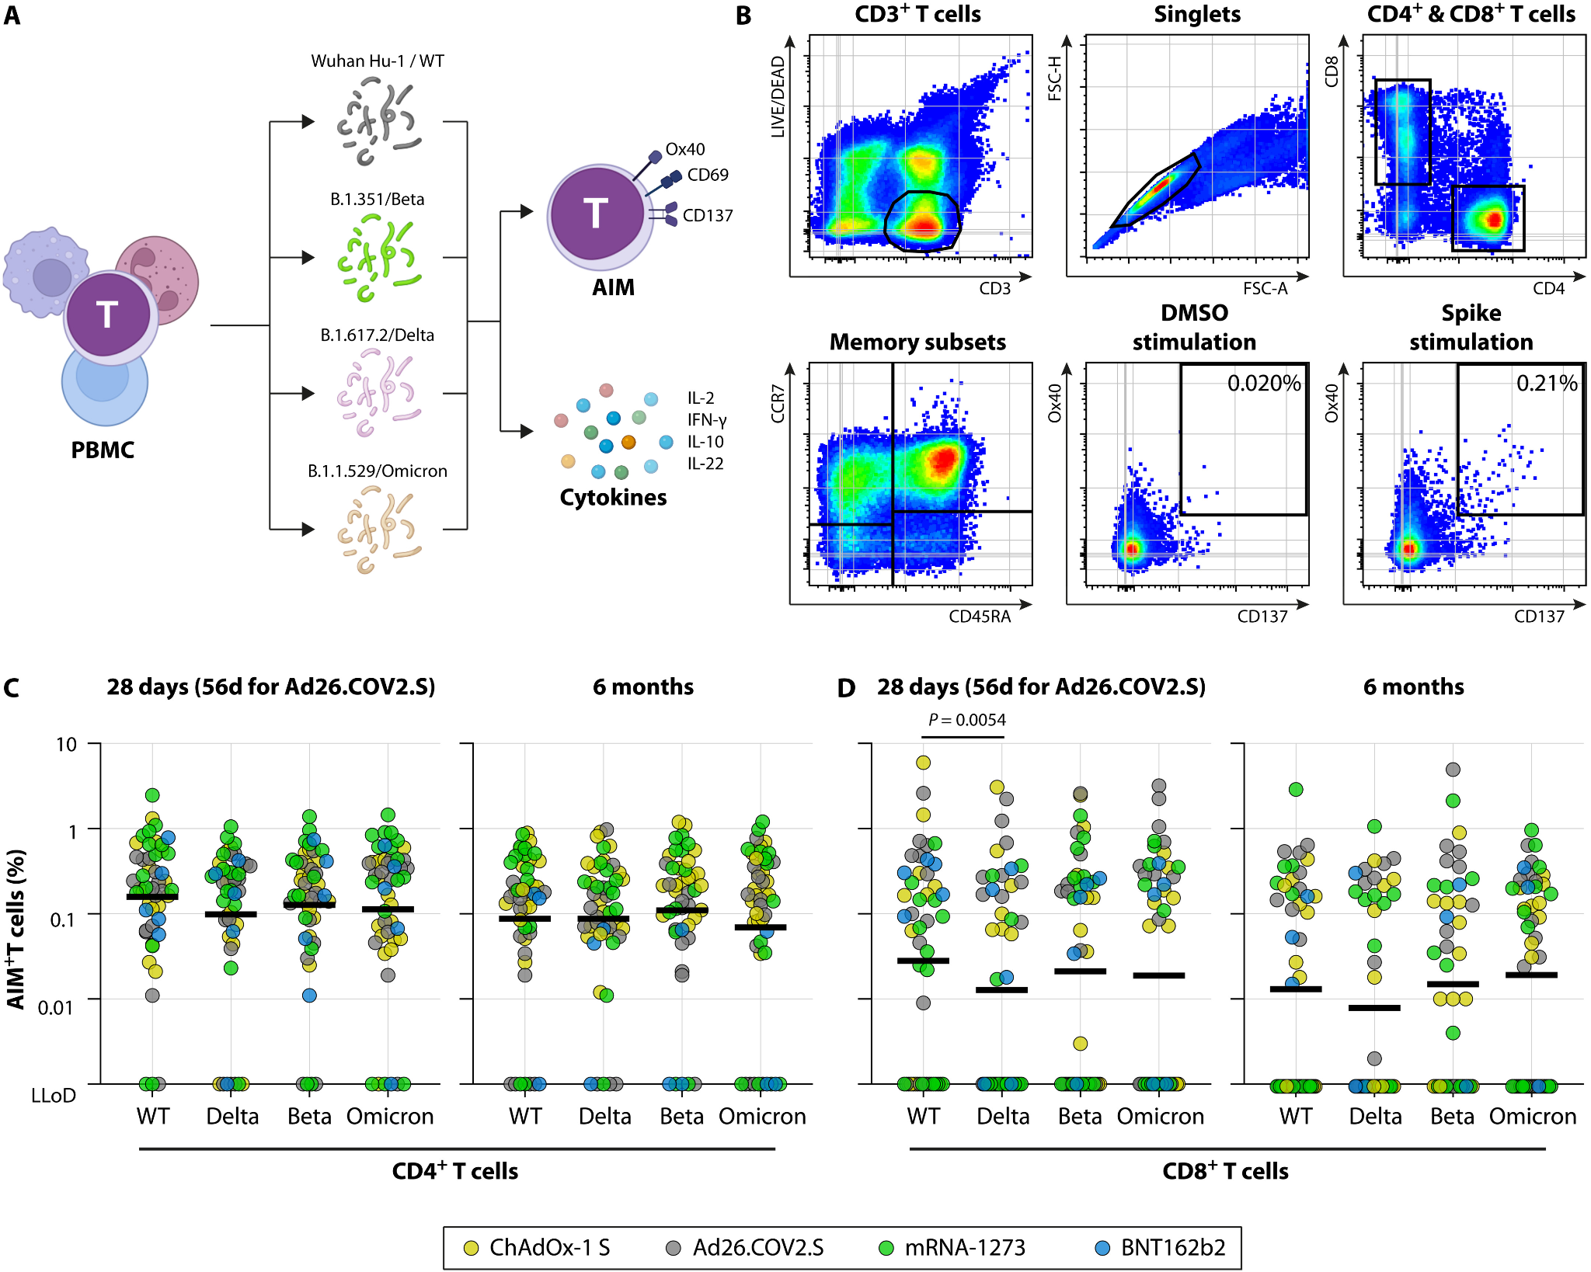
Figure 3 | SARS-CoV-2 variant-specific T cell responses
Activates CD4 and CD8 T cells
Height and Area
13 cytokines
Activated T cells

Slide 18
Figure 3 | SARS-CoV-2 variant-specific T cell responses
LLoD = Lower Limit of Detection

Slide 19
Cohort | n | Age (median years, 95% CI) | Female (n, %) | Vaccination interval (median days, 95% CI)
Ad26.COV2.S/BNT162b2 | 15 | 37 (28–44) | 10 (67%) | 88 (79–88)
2× mRNA-1273/BNT162b2 | 9 | 29 (27–40) | 7 (78%) | 214 (214–219)

Slide 20
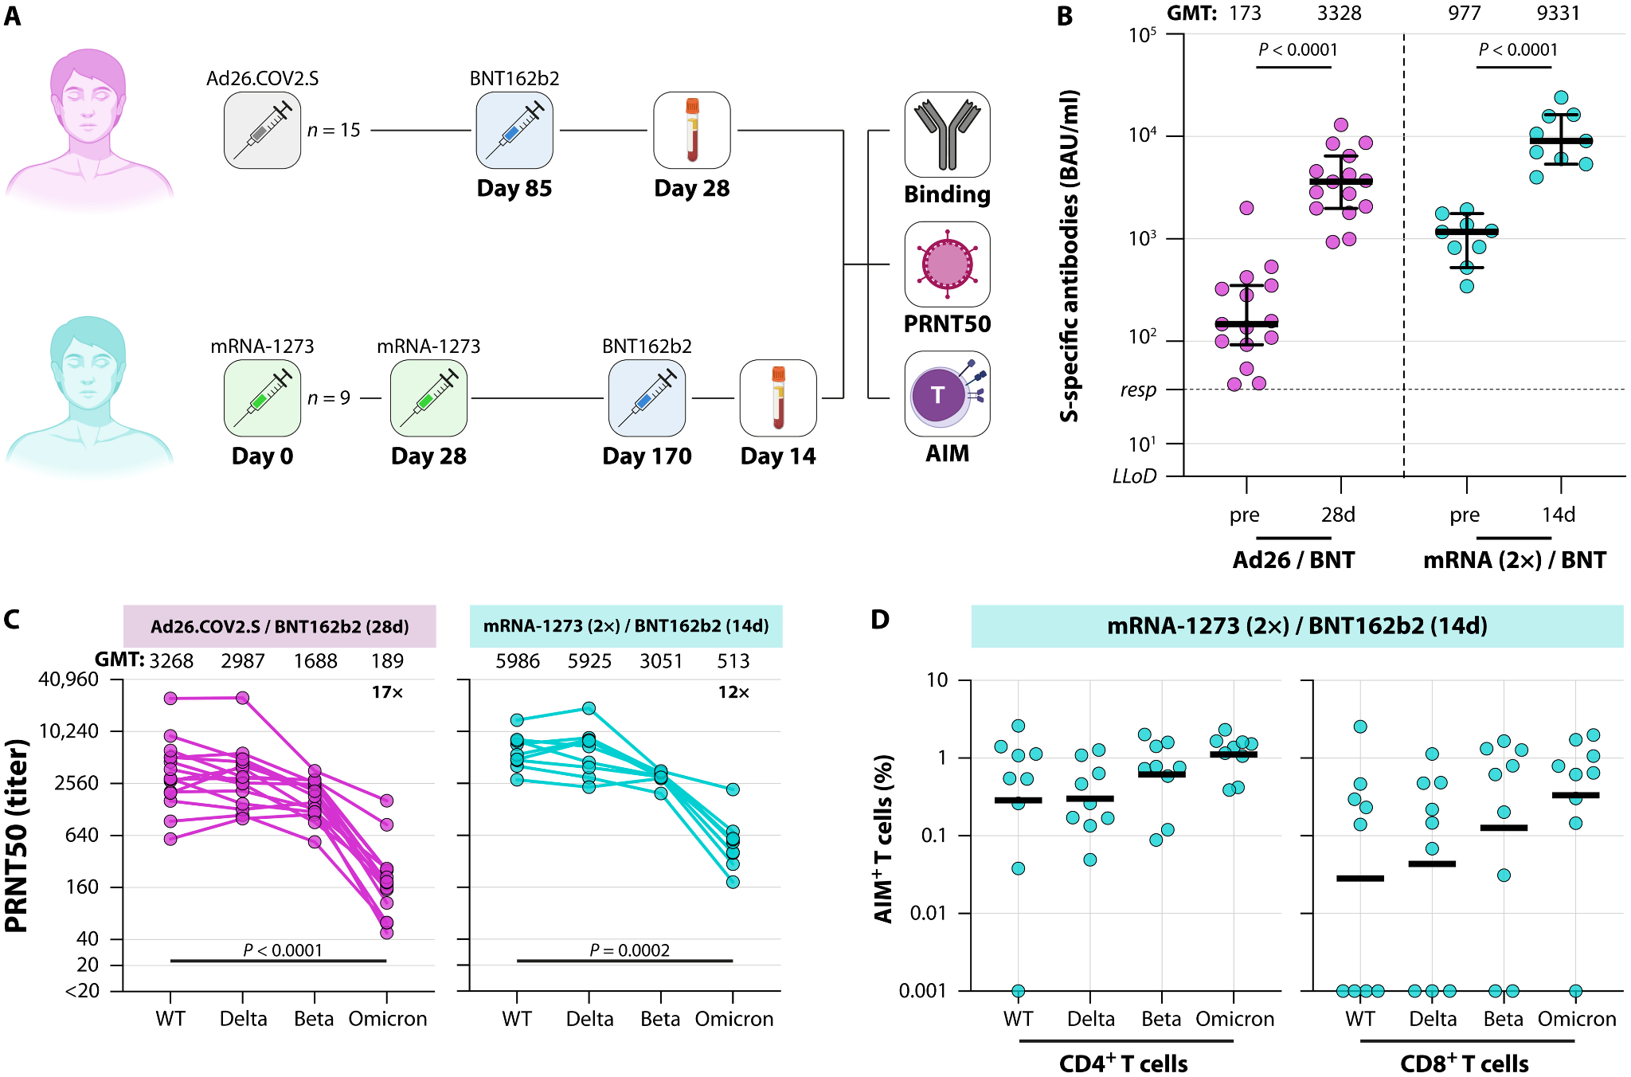
Figure 4 | Variant-specific immune responses early after booster vaccination

Slide 21
Figure 4 | Variant-specific immune responses early after booster vaccination

Slide 22
Main Takeaways
Neutralizing antibody titers reduced up to 30-fold in Omicron compared to WT SARS-CoV-2
T cell responses were minimally affected by mutations in the Spike protein
High levels of neutralizing antibodies were observed after mRNA vaccination
Omicron neutralization was restored following booster vaccination

Slide 23
Study Limitations
Sample size was only 15 donors per vaccine - very small compared to number of people in the world who have been vaccinated!
Post-vaccination data was limited - what happened to study participants after 6 months?
Most of the study includes young adult participants (<50) - how would the results be different in older and immunocompromised adults?

Slide 24
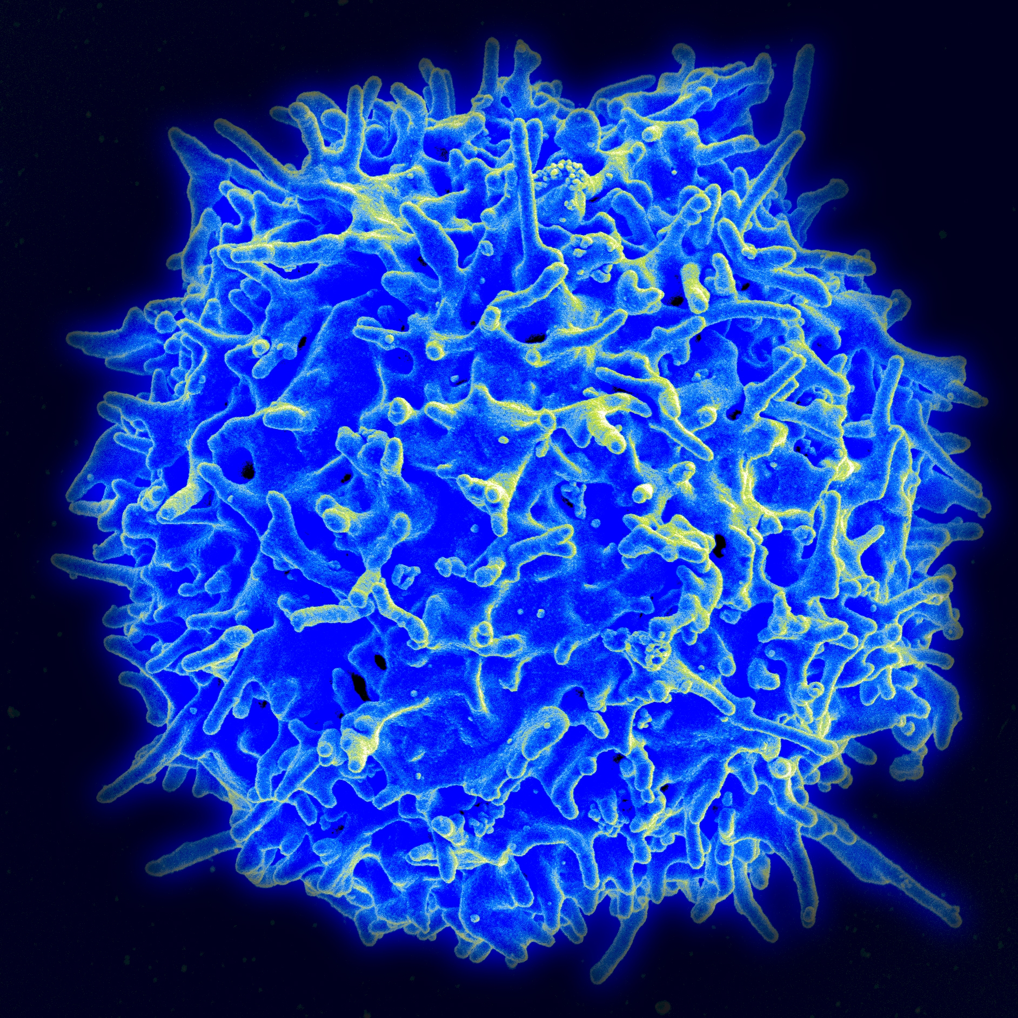
Alternate Perspective: T Cells might be more critical!
Ledford et al. argue that T cells might play a more important role in neutralizing infection
Levels are higher after infection
T cells can recognize more sites along the mutated Spike protein
Vaccines made by Pfizer and J&J did not raise high levels of neutralizing antibodies

Slide 25
Discussion/Applications
Spontaneous genetic mutations can, hypothetically, give rise to an infinite number of SARS-CoV-2 variants.
Are you optimistic about current boosters being able to neutralize antibodies for future variants?
In the case that a variant is highly mutant and infectious, would a variant-specific booster be necessary?
Developing variant-specific boosters is costly and laborious, and there is a possibility that a particular variant won’t come back the next year. Do the potential drawbacks outweigh the benefits?

Slide 26
Questions?

